Slide 1
HelloJulia.jl

Slide 2
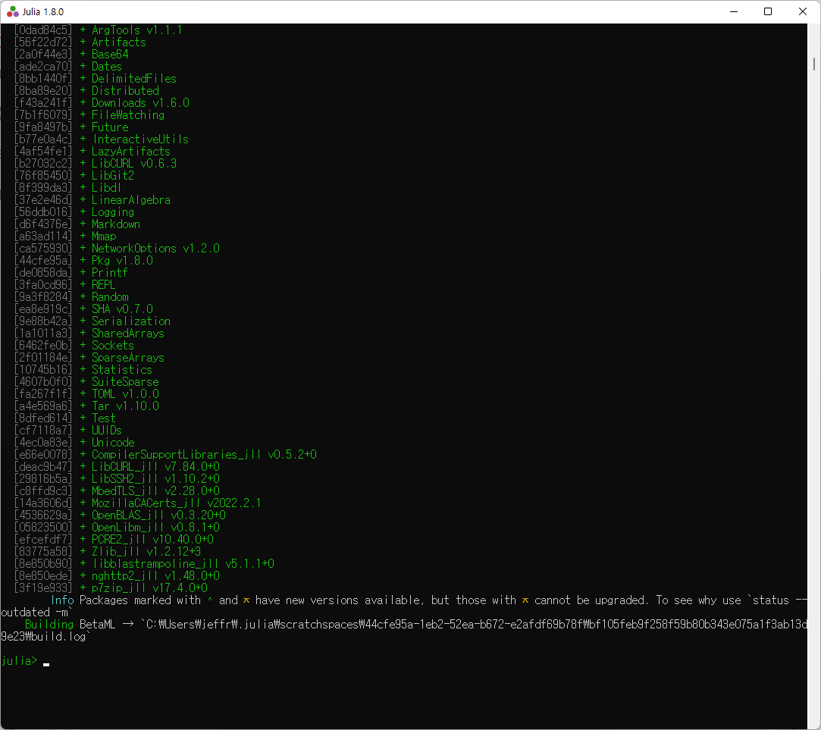
ENV["JULIA_PKG_PRECOMPILE_AUTO"]=0
using Pkg
Pkg.activate(temp=true)
Pkg.develop(url="https://github.com/ablaom/HelloJulia.jl")
Pkg.activate(joinpath(Pkg.devdir(), "HelloJulia"))
Pkg.instantiate()
ENV["JULIA_PKG_PRECOMPILE_AUTO"]=1
using HelloJulia
setup()

Slide 3
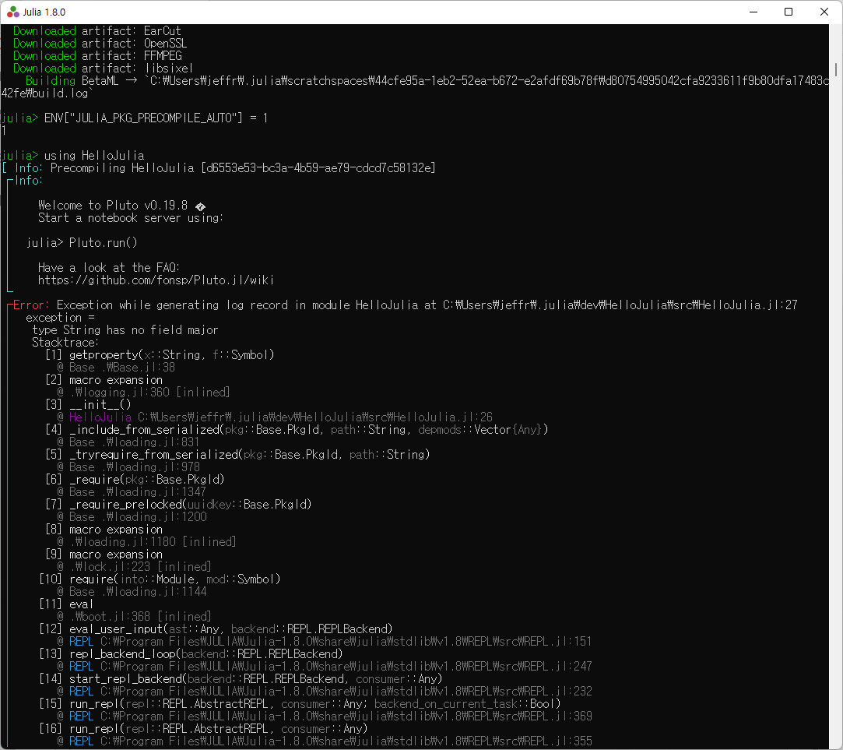

Slide 4
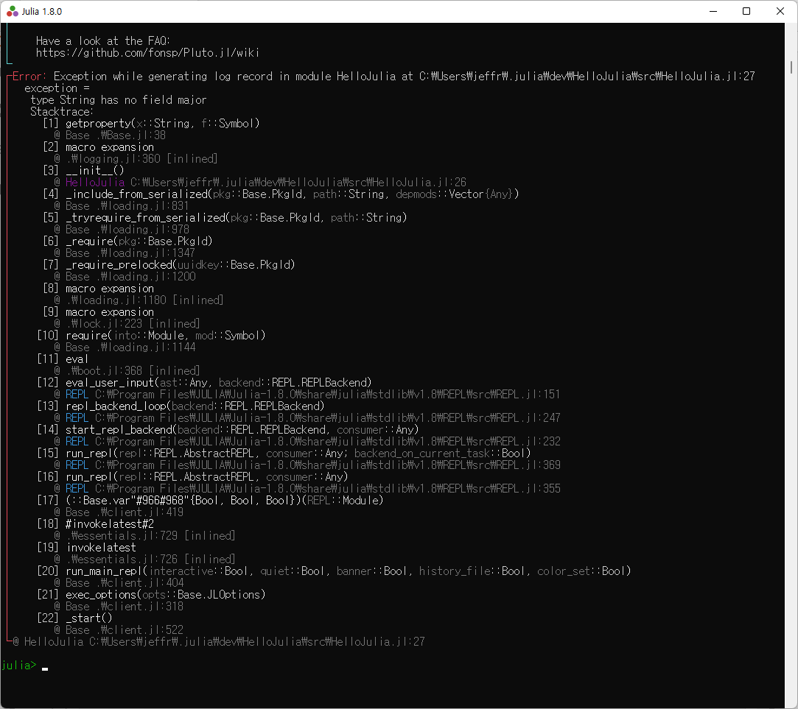

Slide 5
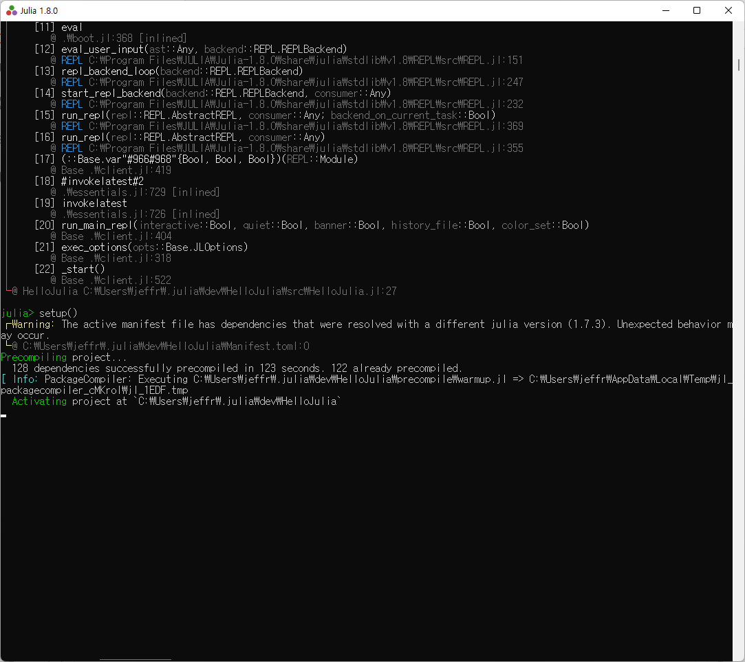

Slide 6
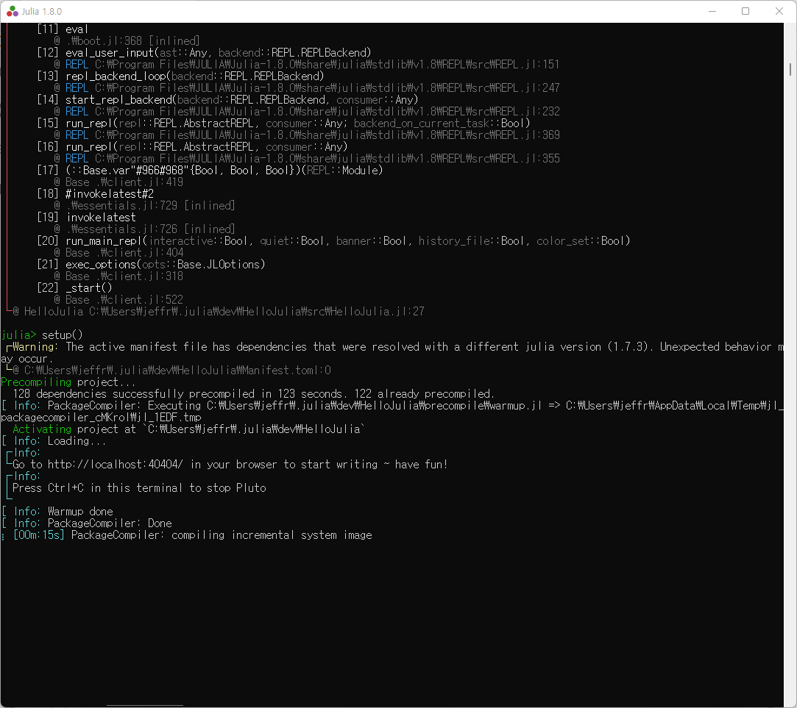

Slide 7
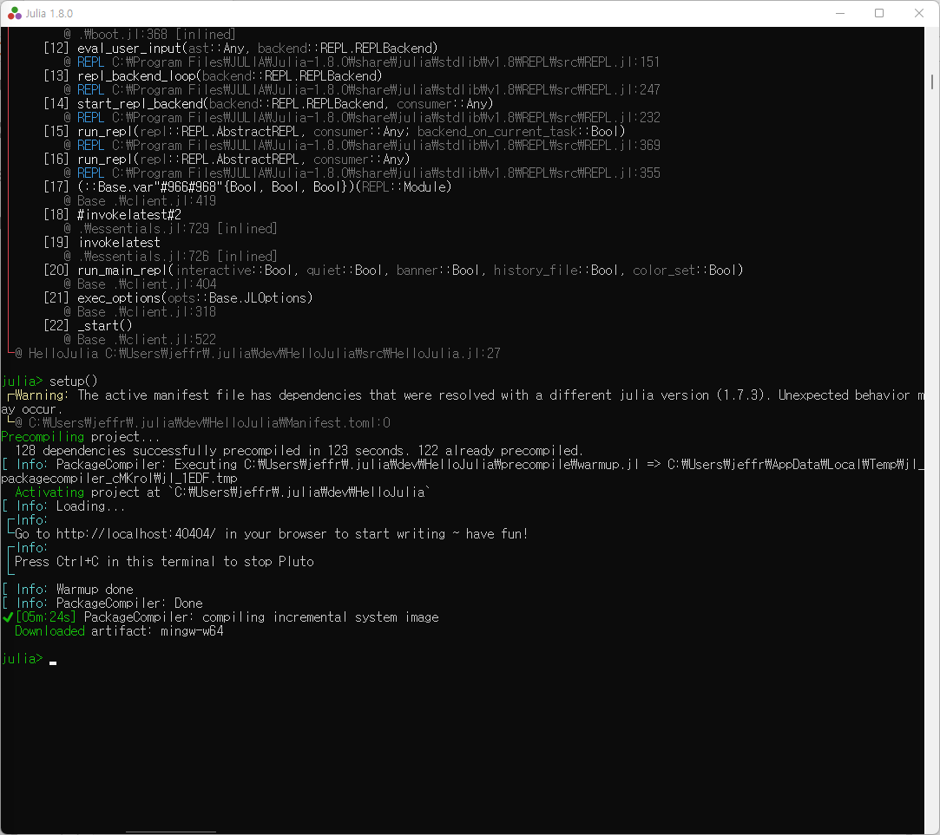

Slide 8
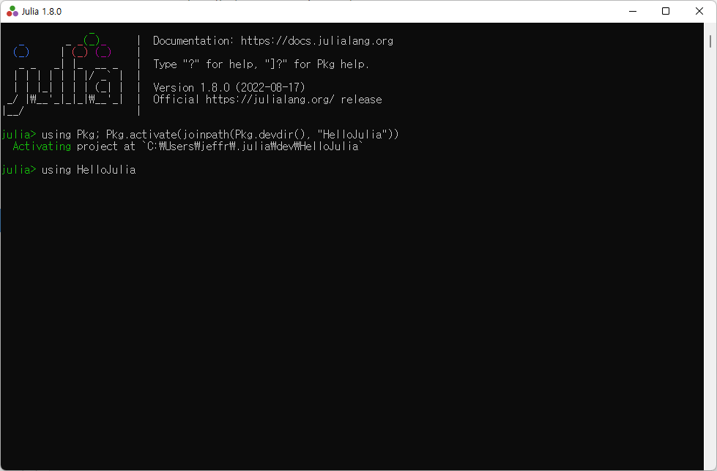

Slide 9
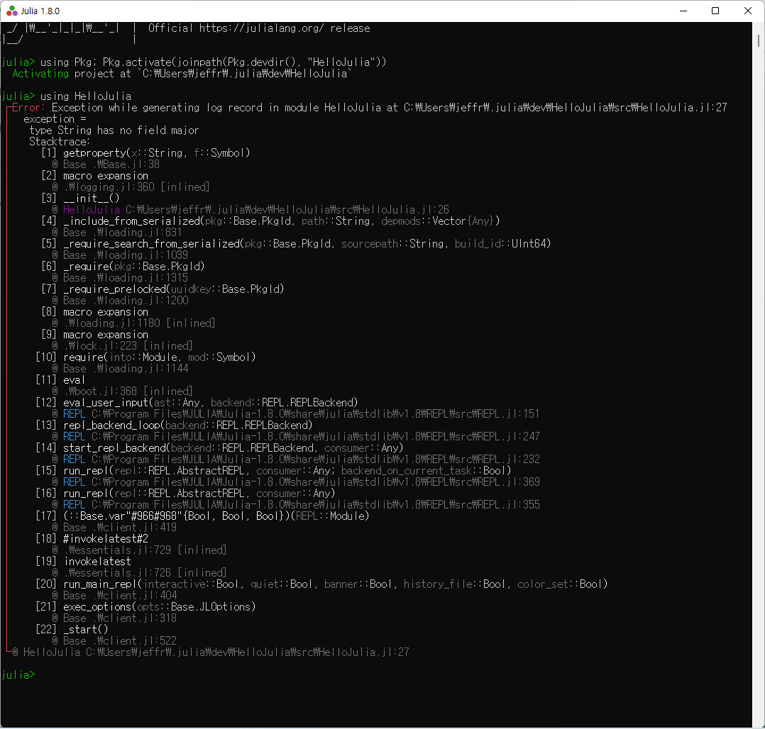

Slide 10
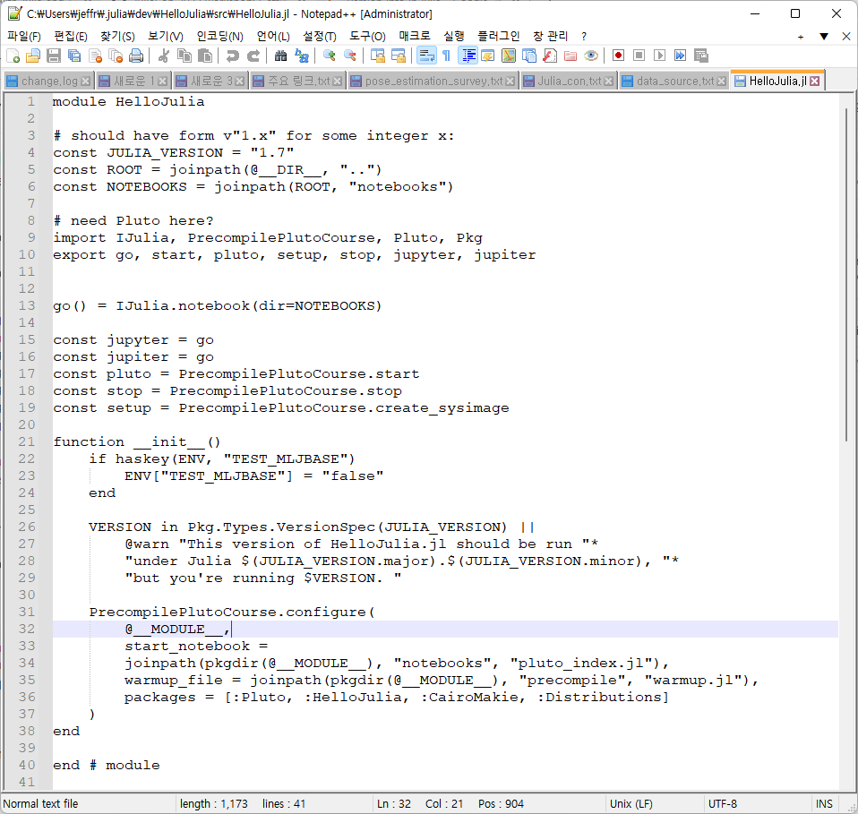

Slide 11
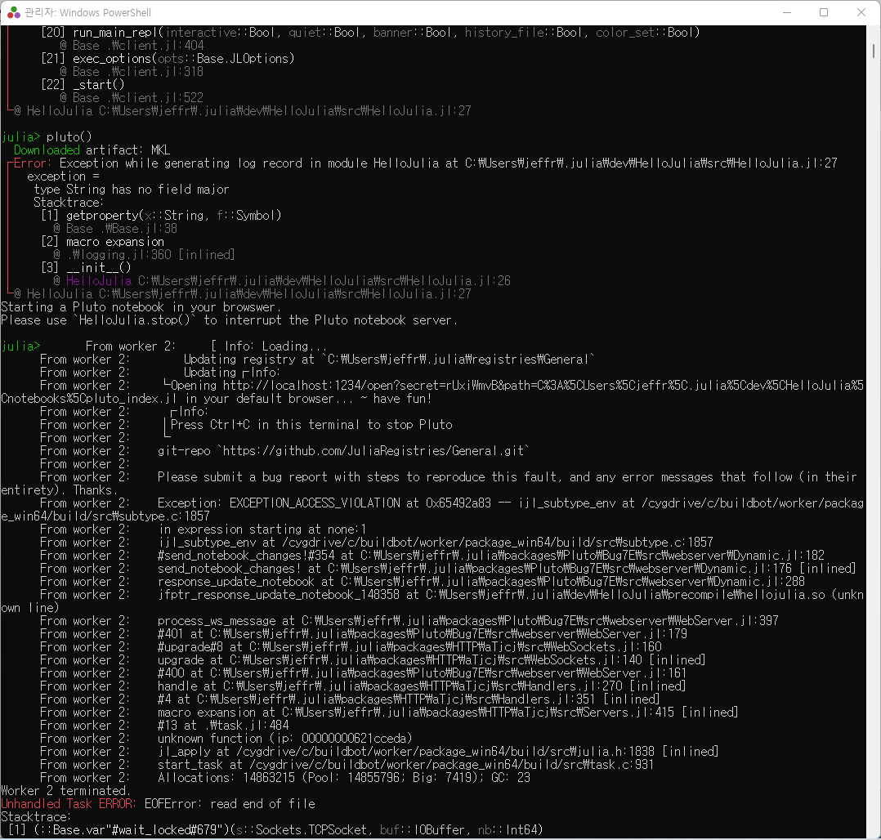

Slide 12
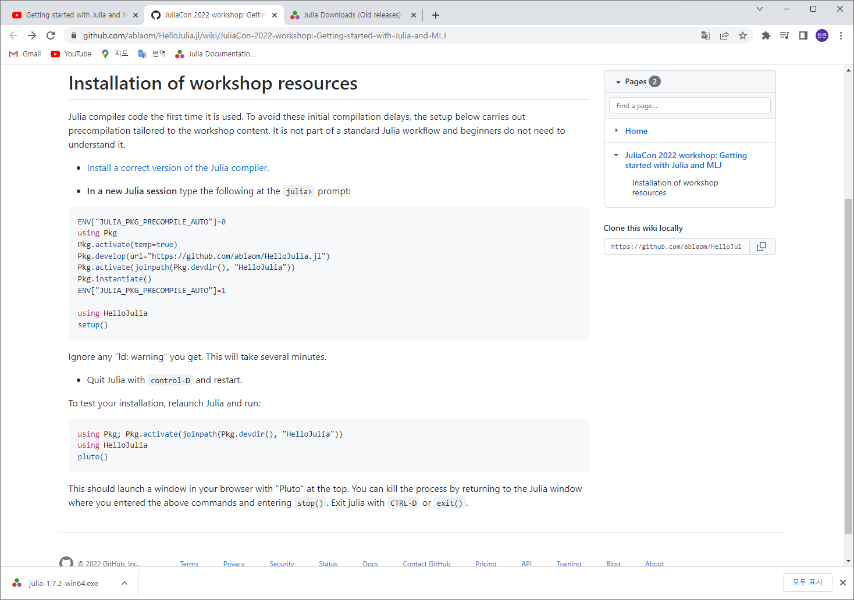

Slide 13
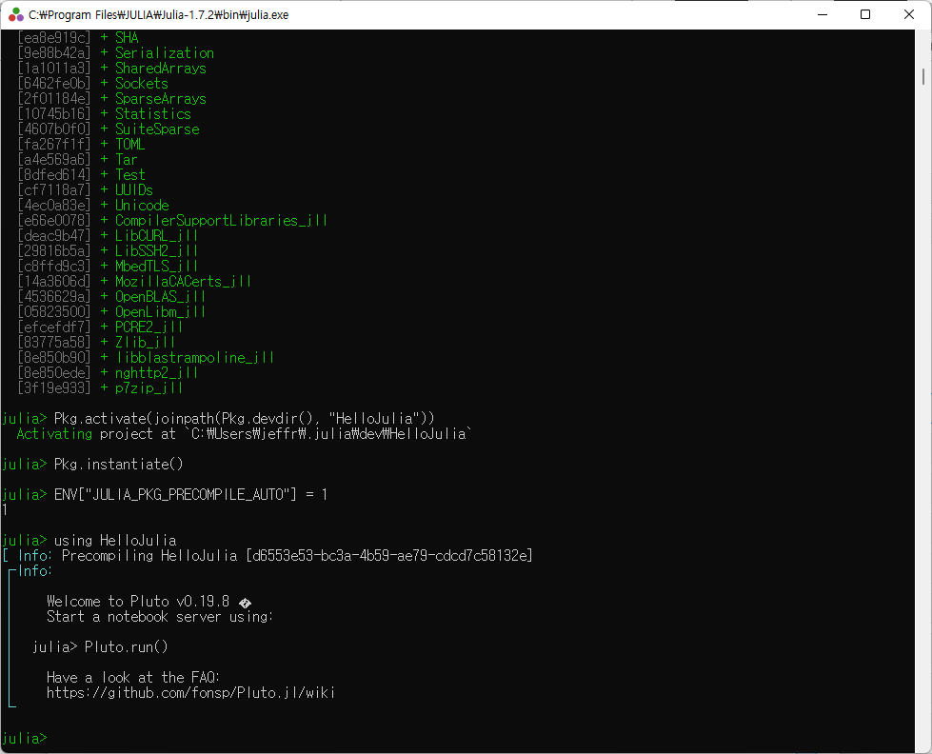

Slide 14
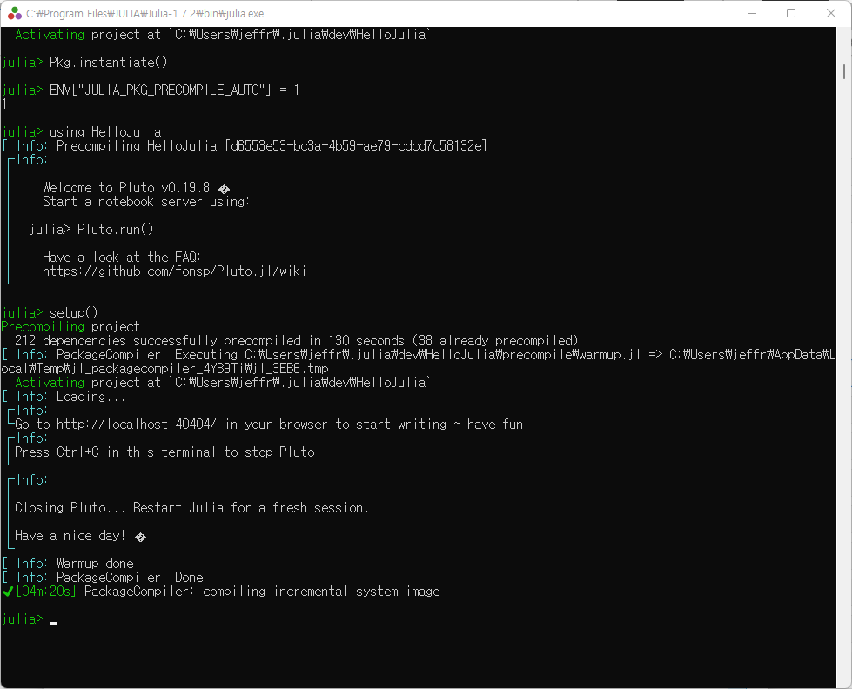

Slide 15
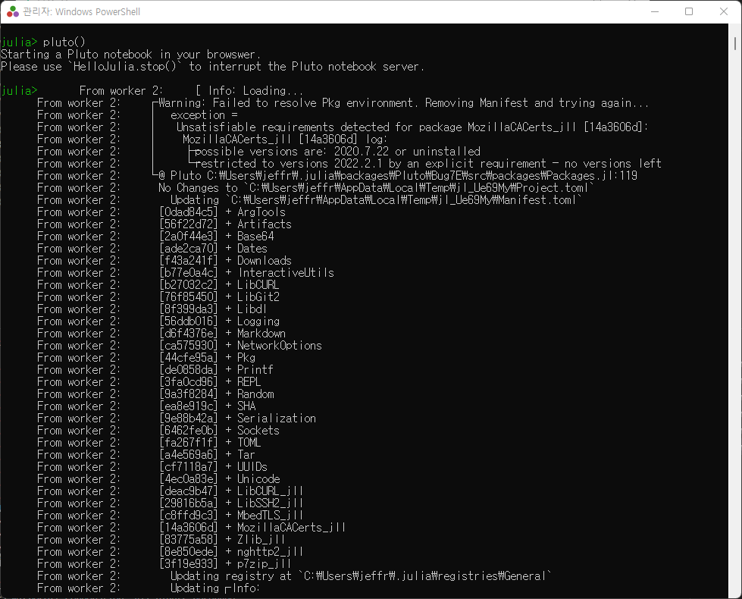

Slide 16
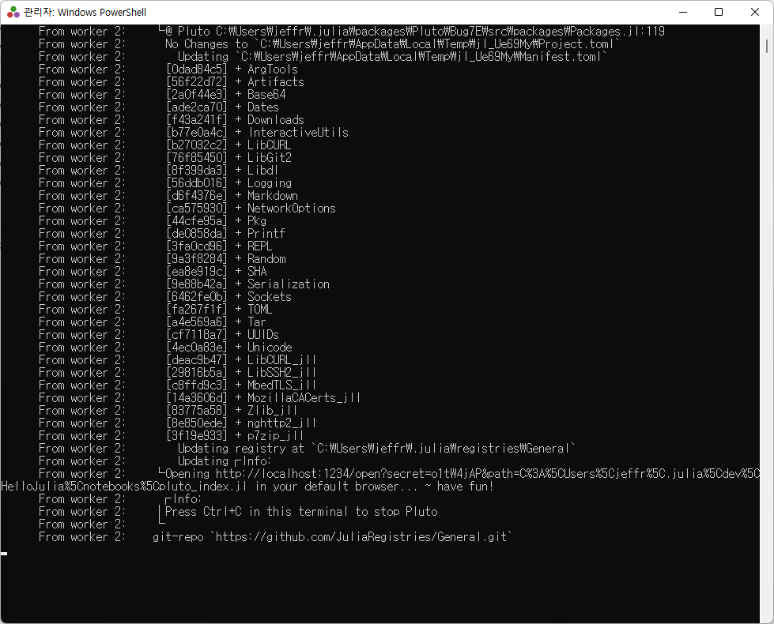

Slide 17
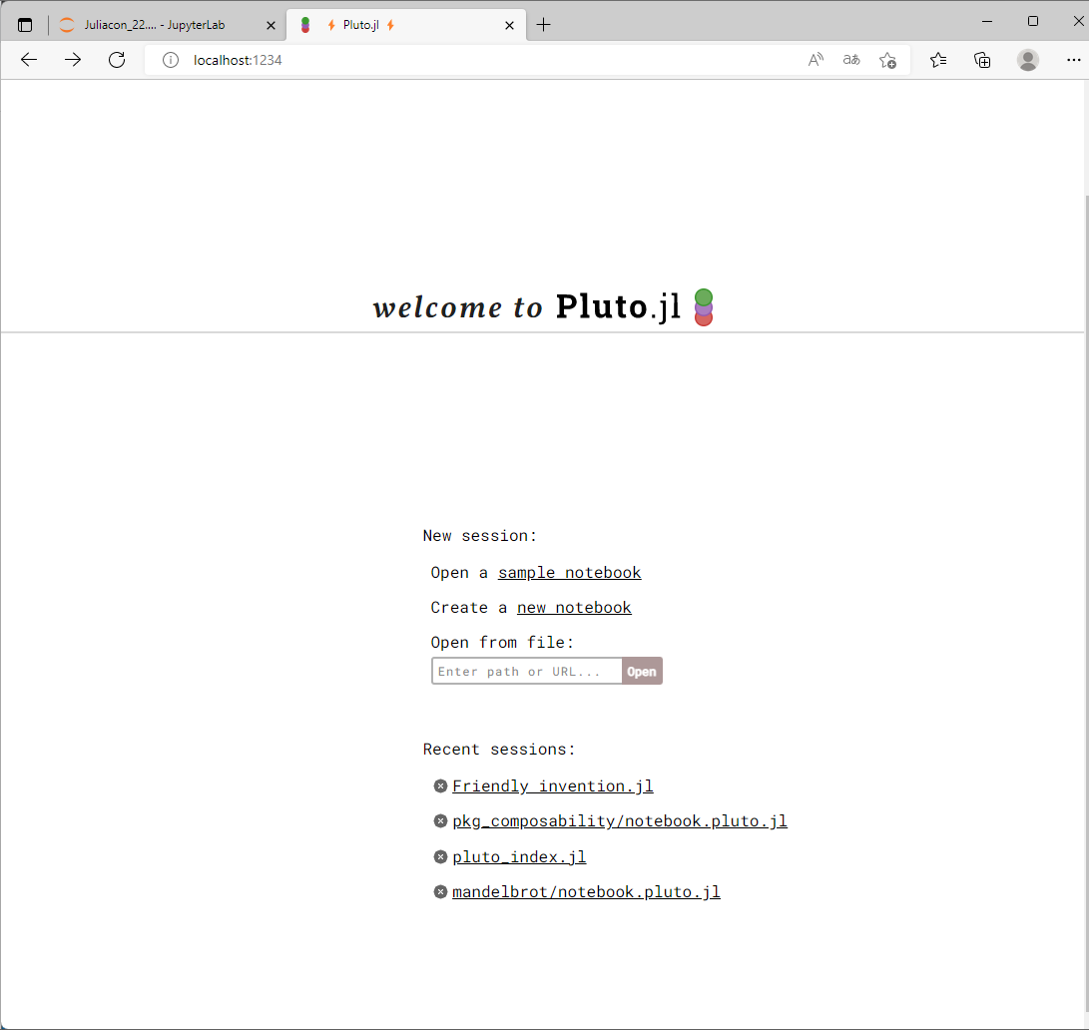

Slide 18
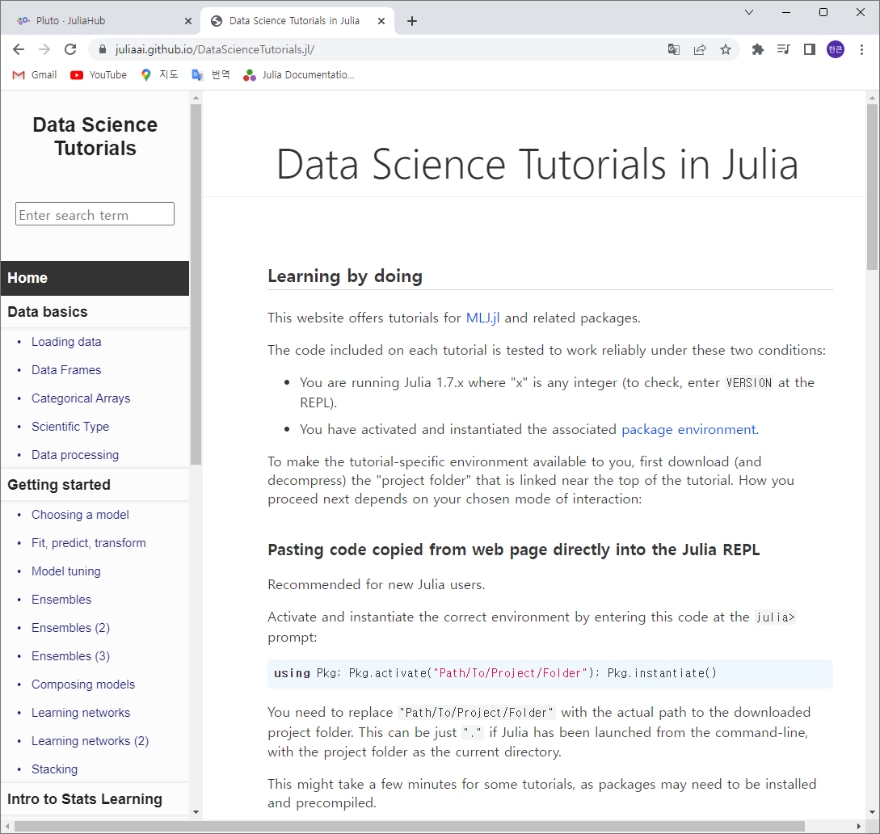
https://juliaai.github.io/DataScienceTutorials.jl/

Slide 19
Julia 1.7.3
setting environments

Slide 20
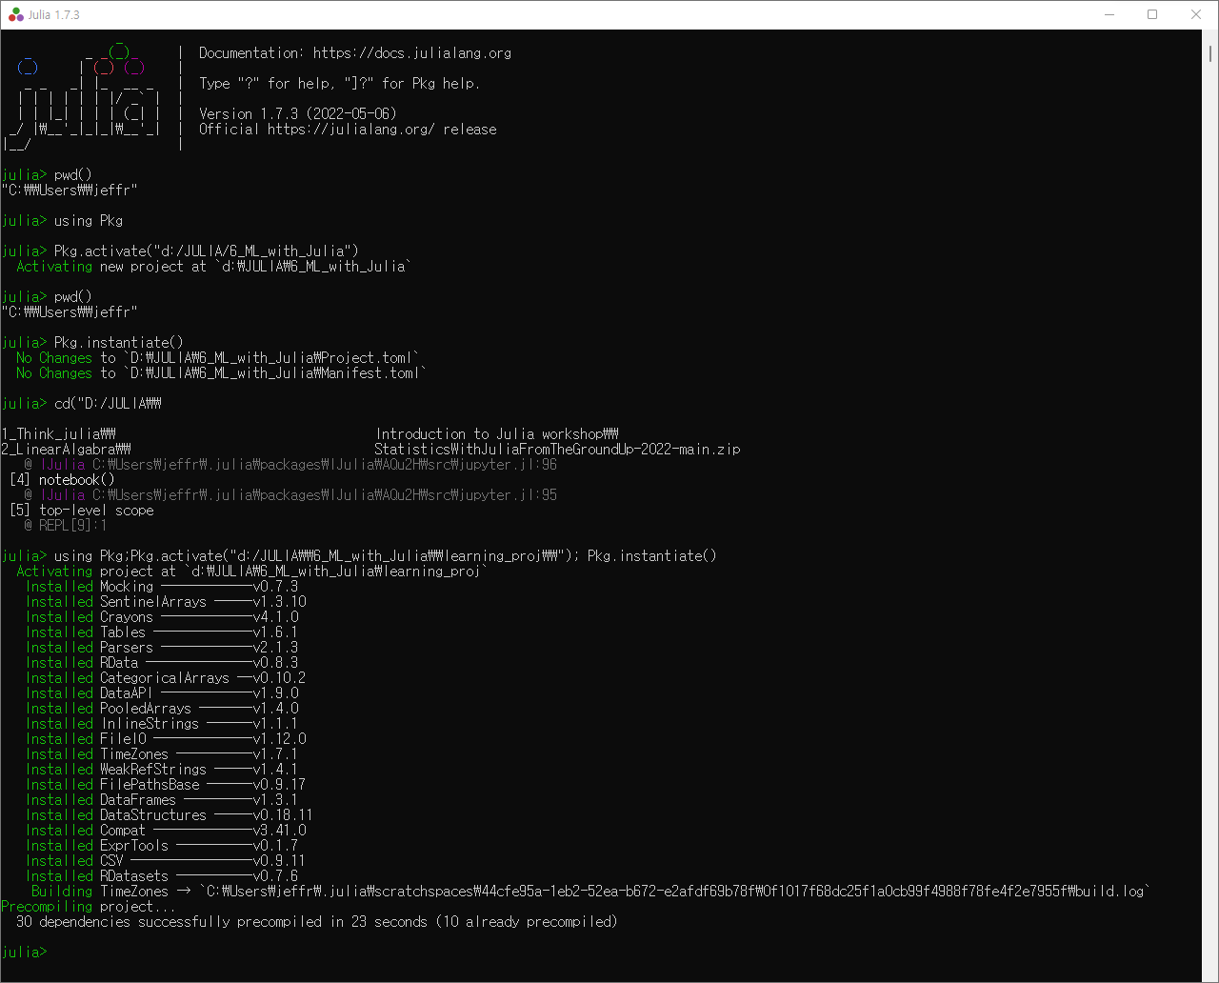

Slide 21
MLJ

Slide 22
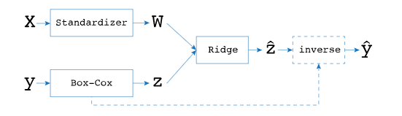

Slide 23
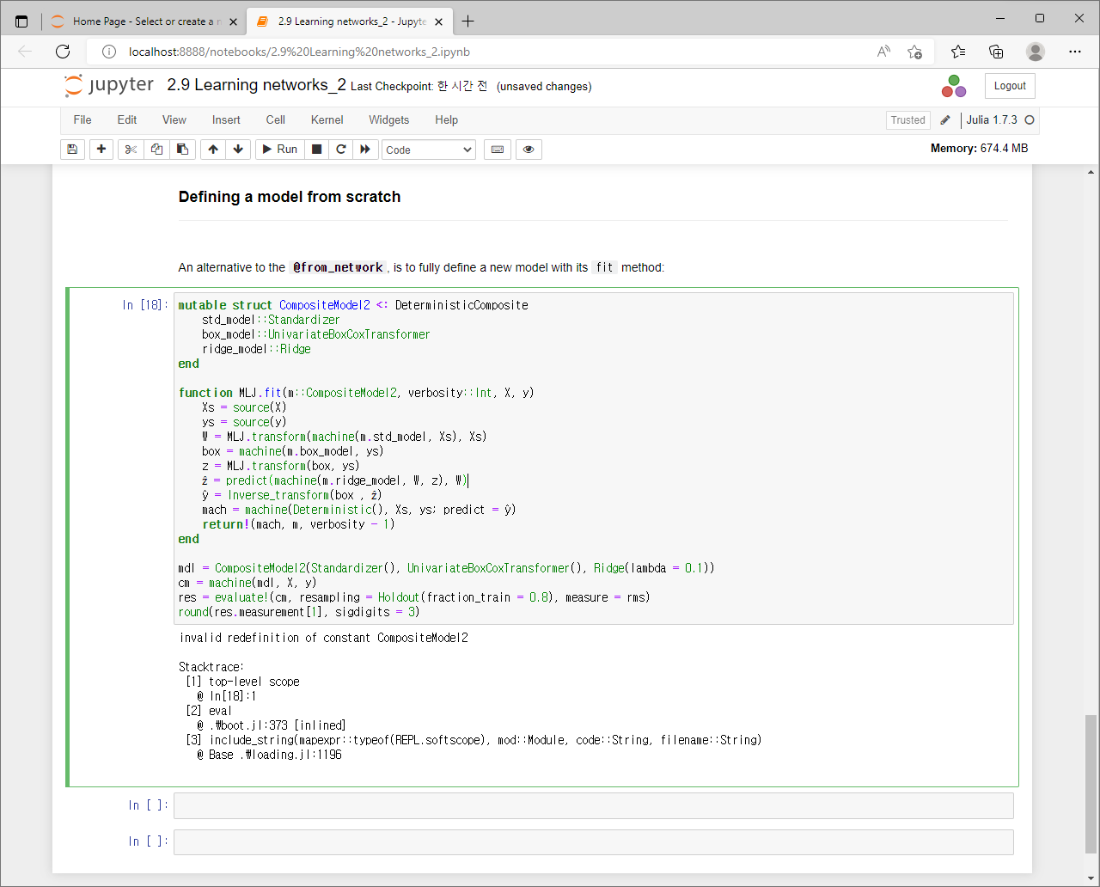

Slide 24
https://stackoverflow.com/questions/70800177/delete-full-workspace-or-one-variable-in-julia/70800602
줄리아의 오픈 이슈

Slide 25
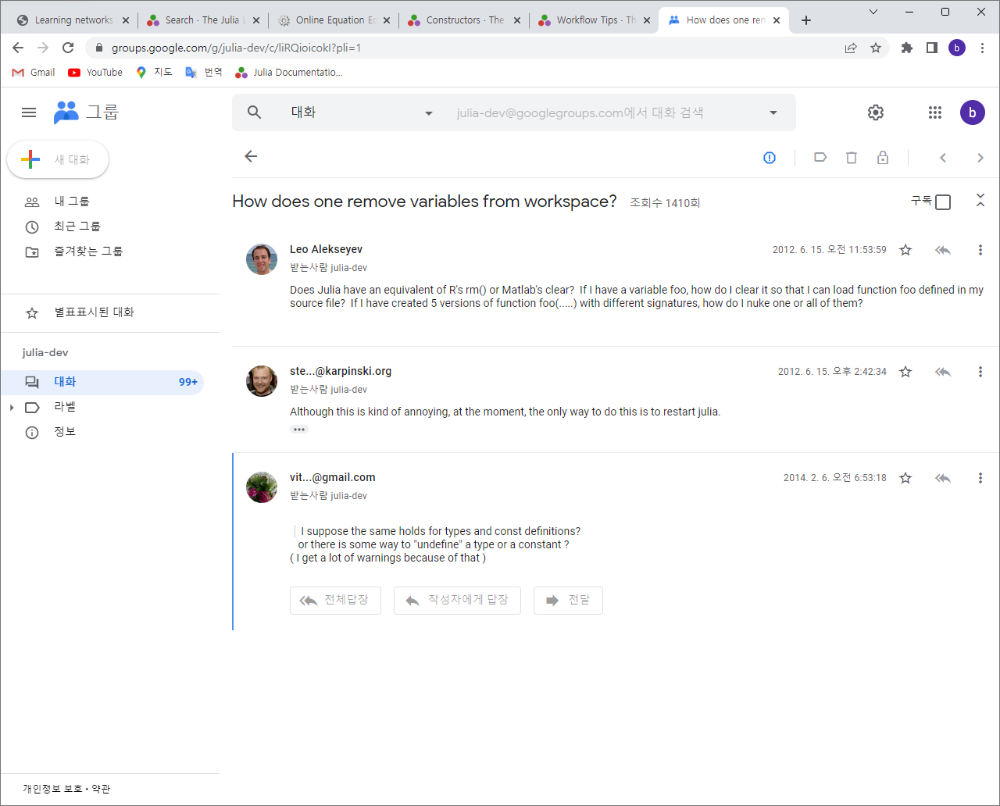

Slide 26
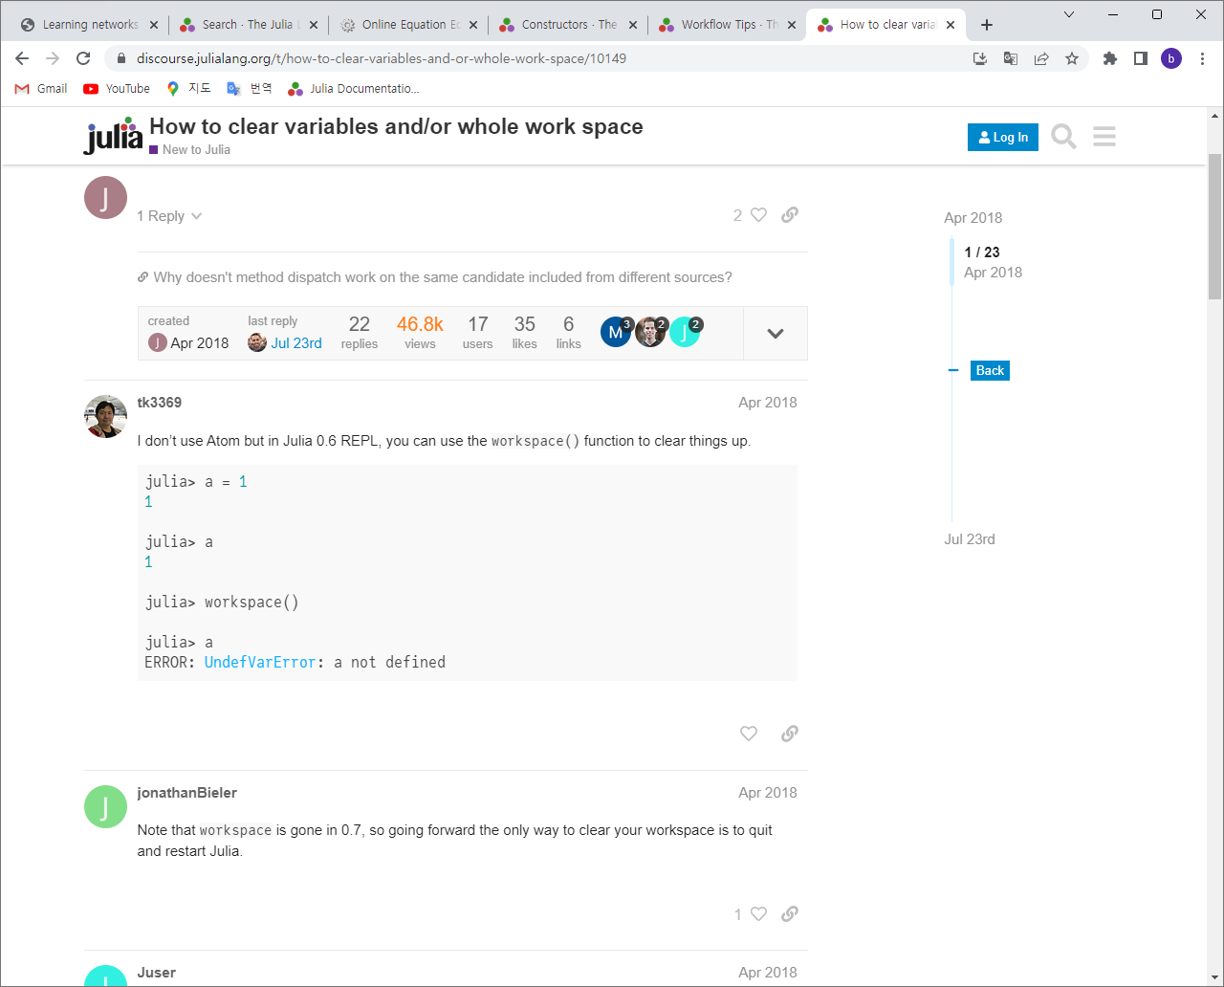

Slide 27
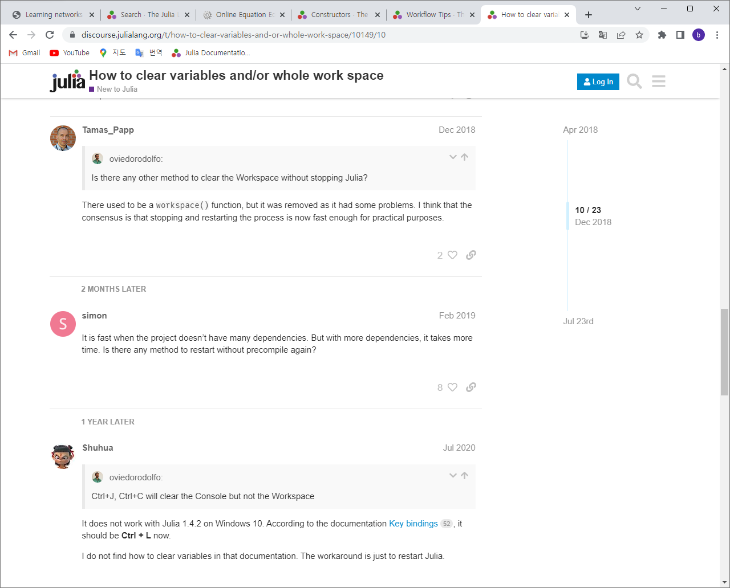

Slide 28
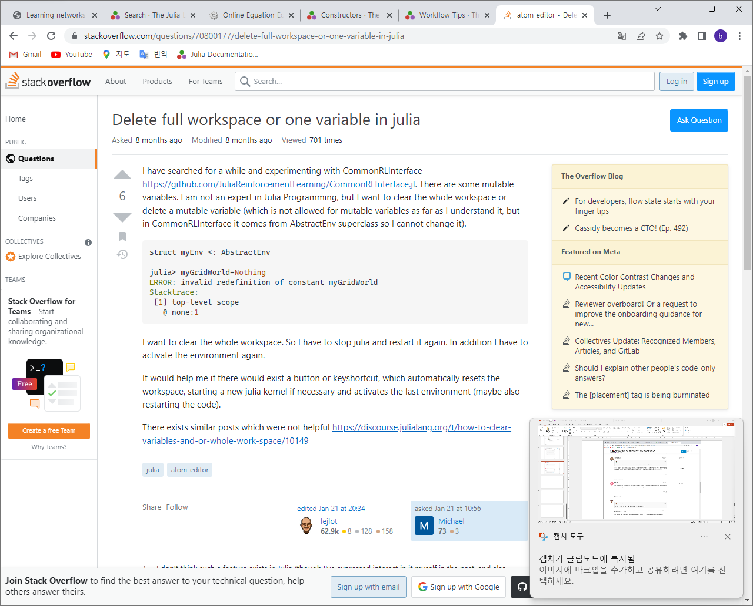

Slide 29
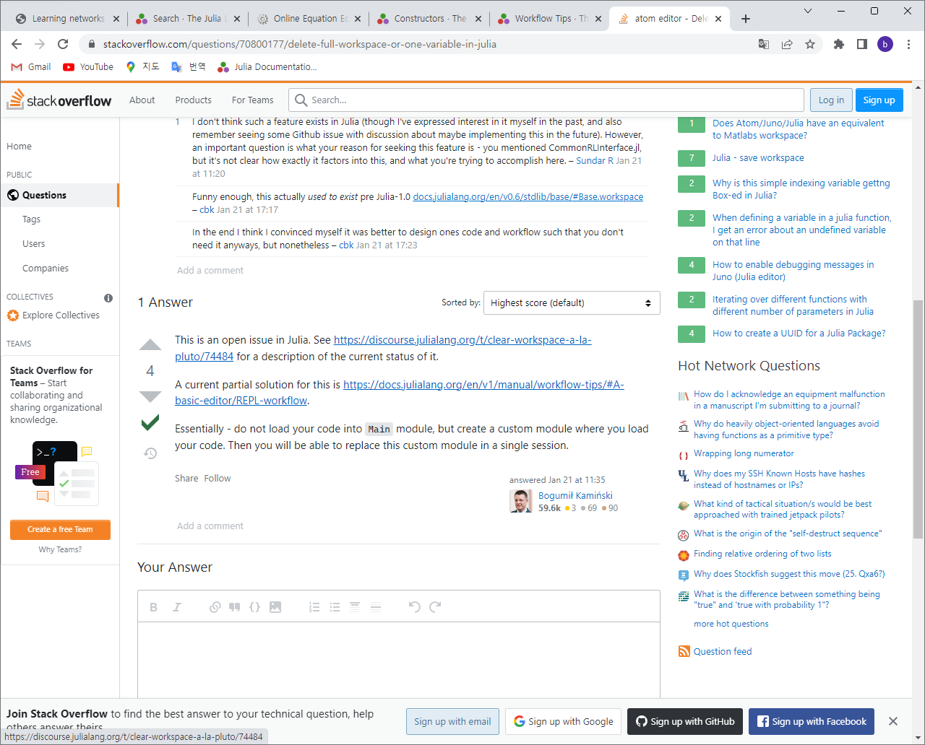

Slide 30
